Slide 1
Currciulum Project
Lucas Brown
Northern State University
MUSC 777- Curriculum Writing in Music Education
Dr. Wendy vanGent

Slide 2
My Role as an Educator
Teach Pre-K- 6th Grade Music, Elementary Choir 4-6 Grade, 4th Grade Beginning Band Lessons, Beginning Band, Advanced Band, Drum Circle, Elementary Musical Theater.
Notes:
In my current position I currently teach Pre-School through 6th Grade General Music, Elementary Choir (grades 4-6), 4th Grade Beginning Band Lessons, 4th Grade Beginning Band, Advanced Band (5th and 6th Grade), Drum Circle, and Direct the Elementary Musical Theater Program (Grade 4-6 during the year, and grades 2-6 in the summer).

Slide 3
Pine Grove School
Core Values and Beliefs
At Pine Grove School our mission is to be a respectful, safe and collaborative community of invested learners.
We strive for academic excellence by celebrating the whole child, valuing diversity and fostering communication.
Our Core Values:
Excellence, Integrity, Teamwork and Attitude
Abridged Version:
Pine Grove School is a respectful, safe and collaborative community of invested learners.
Notes:
At Pine Grove School the major focus is on the overall student and their success. When developing this project, I kept that in mind. One of the biggest ideas that was focused on and is a part of my personal teaching philosophy is "I believe in the promise of every child."
Each of these is supported in our Beginning Band Program where we provide a music education for every child.

Slide 4
Pine Grove School Demographics
Ethnicity
African American- 0.5%
Asian- 1.7%
Hispanic- 2%
Native American- 0.2%
White- 93.7%
Native Hawaiian, Pacific Islander- 0%
Multi-Race, Non-Hispanic- 2%
Language/Special Needs
First Language (Not English)- 4.4%
ELL- 2%
Students with Disabilities- 18.3%
High Needs- 36.6%
Low-Income- 22.4%
Total Number of Students: 2,217 Students in District

Slide 5
Personal Mission Statement
Provide every student a sense of belonging
A welcome environment
A sense of belonging for all creative individuals
A safe place to build confidence in their skills
Every student can learn music, no matter their background
Positive and encouraging Teacher-Student relationships
Appendix A
Notes:
My personal mission statement is important to the way that I interact with my students. The enjoyment of music is important for every student I strive to work and provide them with positive and encouraging experiences in our lessons. This curriculum project is designed for my 4th grade beginning band.

Slide 6
What I Believe…..
Putting Student Interests First
Nurturing each students' interests
Creating well-rounded citizens
Creativity through encouragement
Creating life-long learners
Every child can learn an instrument
The Promise of Every Child

Slide 7
Philosophy
MLT
Brunner’s Spiral Curriculum
ZPD
Blooms Taxonomy

Slide 8
Massachusetts Arts Standards Novice Solo and Ensemble Standards
Creating
Generate and conceptualize artistic ideas and work. Improvise short melodic and rhythmic ideas that reflect characteristics of different genres. (N.M.Cr.01)
2. Organize and develop artistic ideas and work. Record decisions about accuracy of written music (e.g., adding reminder of key signature, or indicating beat subdivisions for a difficult rhythm). (N.M.Cr.02)
3. Refine and complete artistic work. Refine musical interpretations exploring different elements (e.g. dynamics and articulations). (N.M.Cr.03)

Slide 9
Massachusetts Arts Standards Novice Solo and Ensemble Standards
Performing
4. Select, analyze and interpret artistic work for presentation. Identify basic strategies musicians use to practice and employ them in readying a musical work for performance. (N.M.P.04)
5. Develop and refine artistic techniques and work for presentation. Perform with accuracy and expression works from the vocal or instrumental literature with a level of difficulty of 2, on a scale of 1 to 6; or a comparable scale. (N.M.P.05)
6. Convey meaning through the presentation of artistic work. Match a musical performance with expressed intent (e.g., wanting the audience to identify with an emotion). (N.M.P.06)

Slide 10
Massachusetts Arts Standards Novice Solo and Ensemble Standards
Responding
7. Perceive and analyze artistic work. Analyze how cultures are reflected in a diverse range of musical works. (N.M.R.07)
8. Interpret intent and meaning in artistic work. Explain how a musical work is connected to a particular cultural, historical context where it was created. (N.M.R.08)
9. Apply criteria to evaluate artistic work. Develop criteria for a rubric for evaluating musical works (e.g., students create criteria for a performance that is juried by students). (N.M.R.09)

Slide 11
Massachusetts Arts Standards Novice Solo and Ensemble Standards
Connecting
10. Synthesize and relate knowledge and personal experiences to make art. Describe influences of one’s personal musical style and preferences. (N.M.Co.10)
11. Relate artistic ideas and works to societal, cultural and historical contexts to deepen understanding. Identify musical ideas from different cultures studied in history and social science (e.g., American native). (N.M.Co.11)

Slide 12
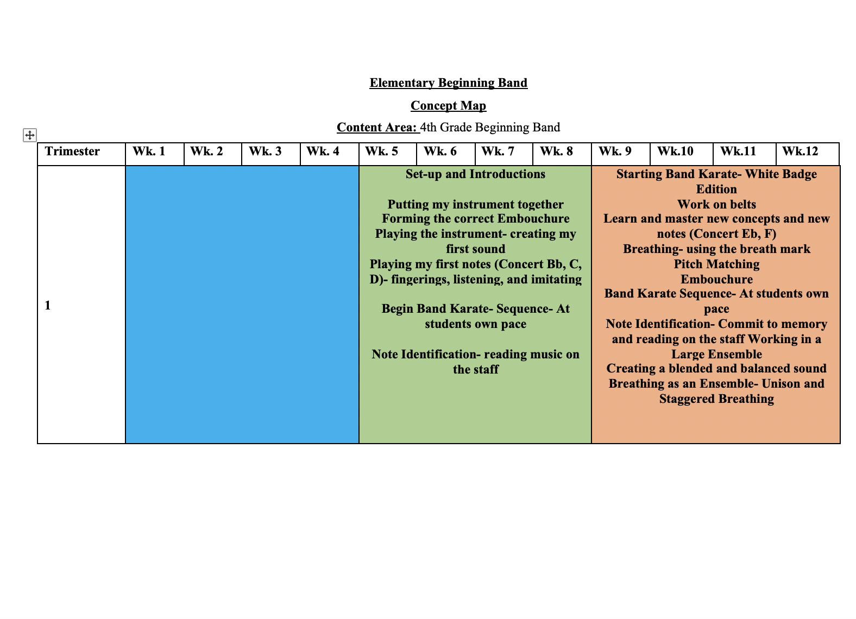

Slide 13
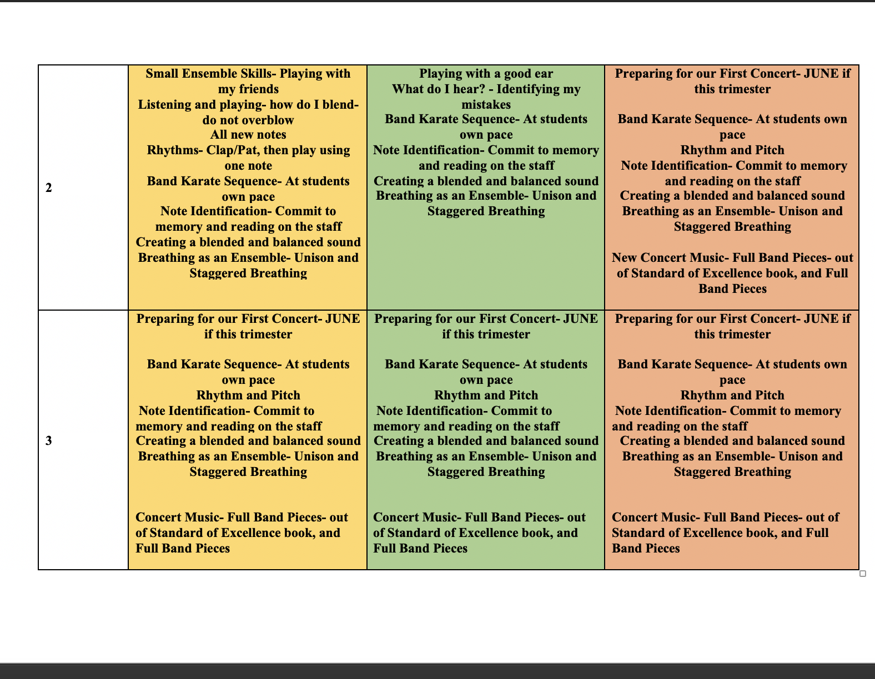

Slide 14
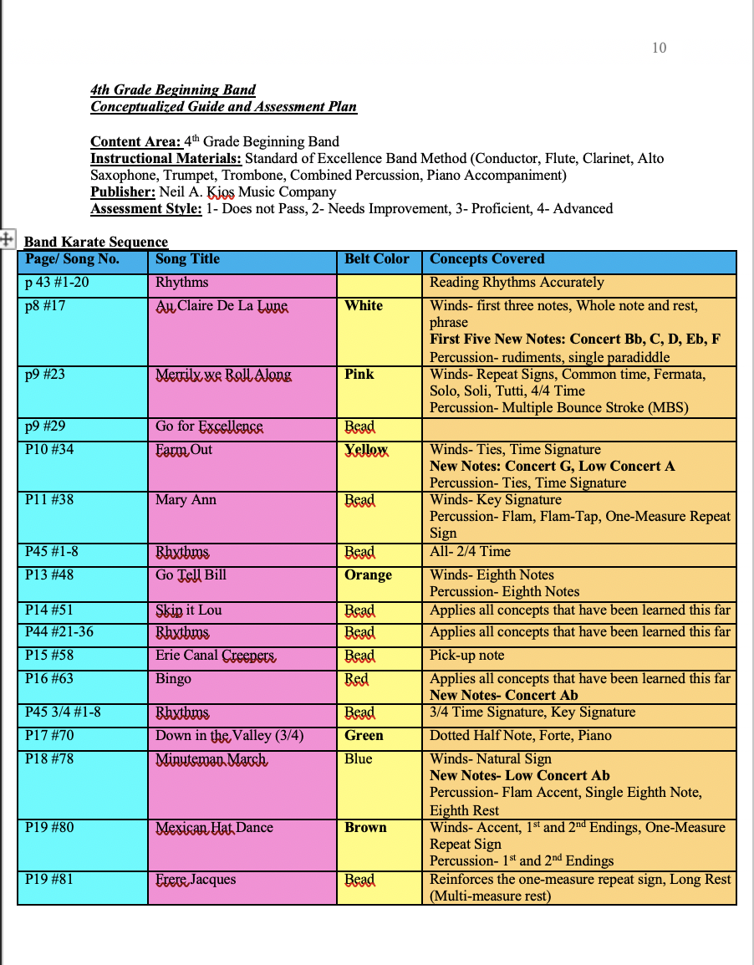

Slide 15
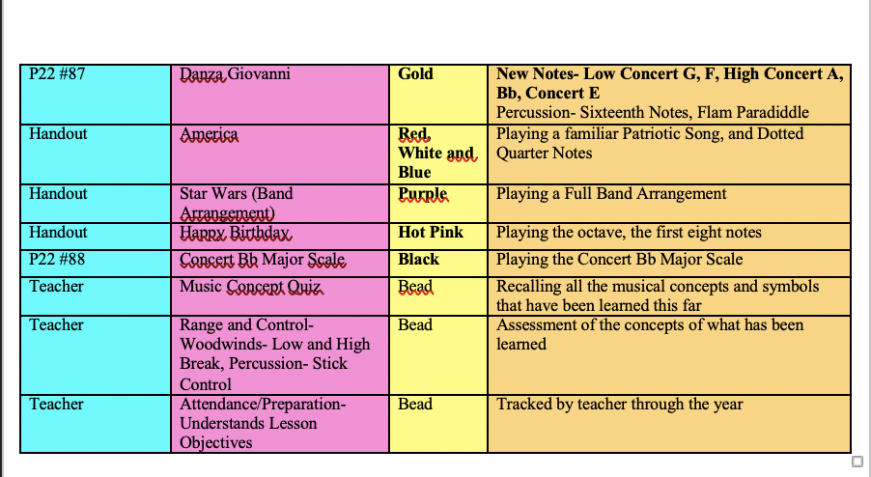

Slide 16
Assessment
Assessment for 4th Grade Beginning Band White Badge
1- Not Quiet There- Student did not meet the requirements to pass the required material. Student will need to practice this material again for next week, student did not know their fingerings, and had to ask for help for most of their notes.
2- Needs Improvement- Student played few notes correctly, had some intonation problems, and had to write in most or all of their notes, and knew a partial amount of their fingerings.
3- Proficient- Student played 50-75 percent of the notes correctly, had to write only few to no notes in, and had pretty good intonation, student knew most of their fingerings and needed little guidance.
4- Advanced- Student played all notes correctly with outstanding intonation, student did not have to write any note names in and knew all their fingerings.

Slide 17
4th Grade Beginning Band
Goals for 4th Grade Beginning Band (1-Year)
In a Group or Individual Lesson Setting:
- Students will produce a good full tone, using a full breath of air.
- Students will listen actively in their lessons, and band rehearsal while playing with other students or in an ensemble setting.
- Students will demonstrate their understanding of basic music concepts on their instrument.
- Students will demonstrate their understanding of basic music terms by sight.
- Students will learn to proficiently read music.

Slide 18
4th Grade Beginning Band
In an Ensemble Setting:
- Students will listen actively to each other while playing in Unison.
- Students will listen actively to each other while playing as an ensemble.
- Students will assess what they hear and share their findings in rehearsal.
- Students will identify their mistakes and discuss it in class.
- Students will demonstrate the ability to play as an ensemble member, while playing their individual part.

Slide 19
References
Bowman, W. D., & Frega, A. L. (2014). The Oxford Handbook of Philosophy in Music Education. Oxford University Press.
Conway, C. M. (2015). Musicianship-focused curriculum and assessment. GIA Publications, Inc.
Massachusetts Department of Elementary and Secondary Education. (n.d.). Current frameworks. Current Curriculum Frameworks - Massachusetts Department of Elementary and Secondary Education. Retrieved June 24, 2022, from https://www.doe.mass.edu/frameworks/current.html
McLeod, S. (2019). Saul McLeod. Constructivism as a Theory for Teaching and Learning | Simply Psychology. Retrieved June 24, 2022, from https://www.simplypsychology.org/constructivism.html
NAfME (2021) Supporting music education: Choose to teach. NAfME. (n.d.). Retrieved December 6, 2021, from https://nafme.org/my-classroom/music-achievement-council-resources-educators/supporting-music-education-choose-teach/.
Pearson, B. (1993). Standard of excellence: Comprehensive band method. Neil A. Kjos Music Company.

