Slide 1
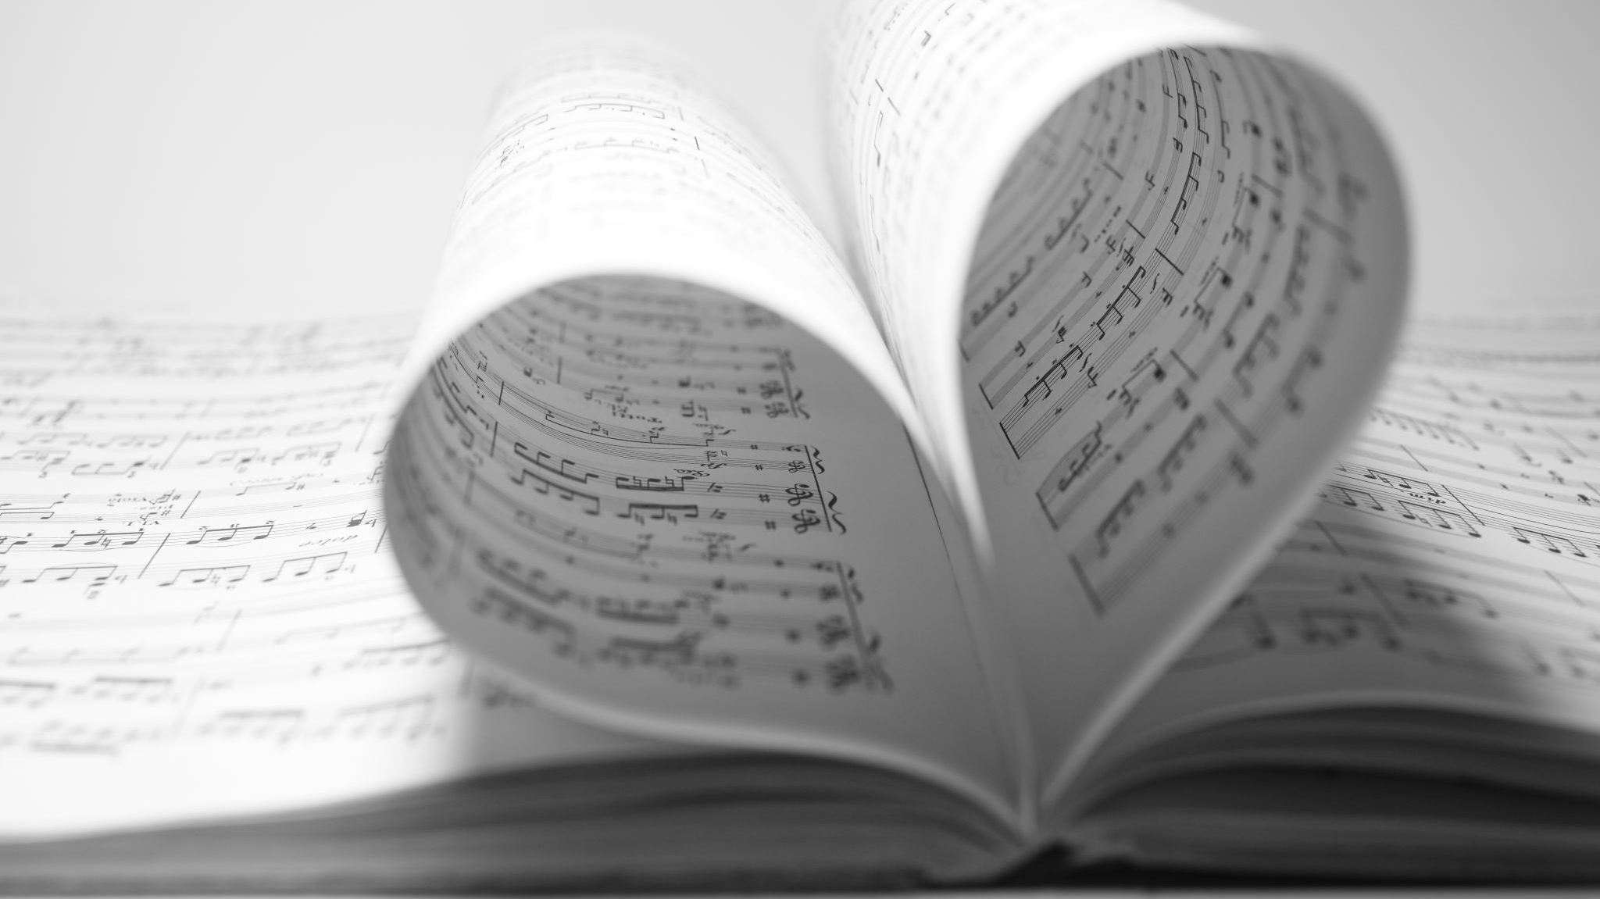
Piano Handbook
Lucas Brown
Northern State University

Slide 2
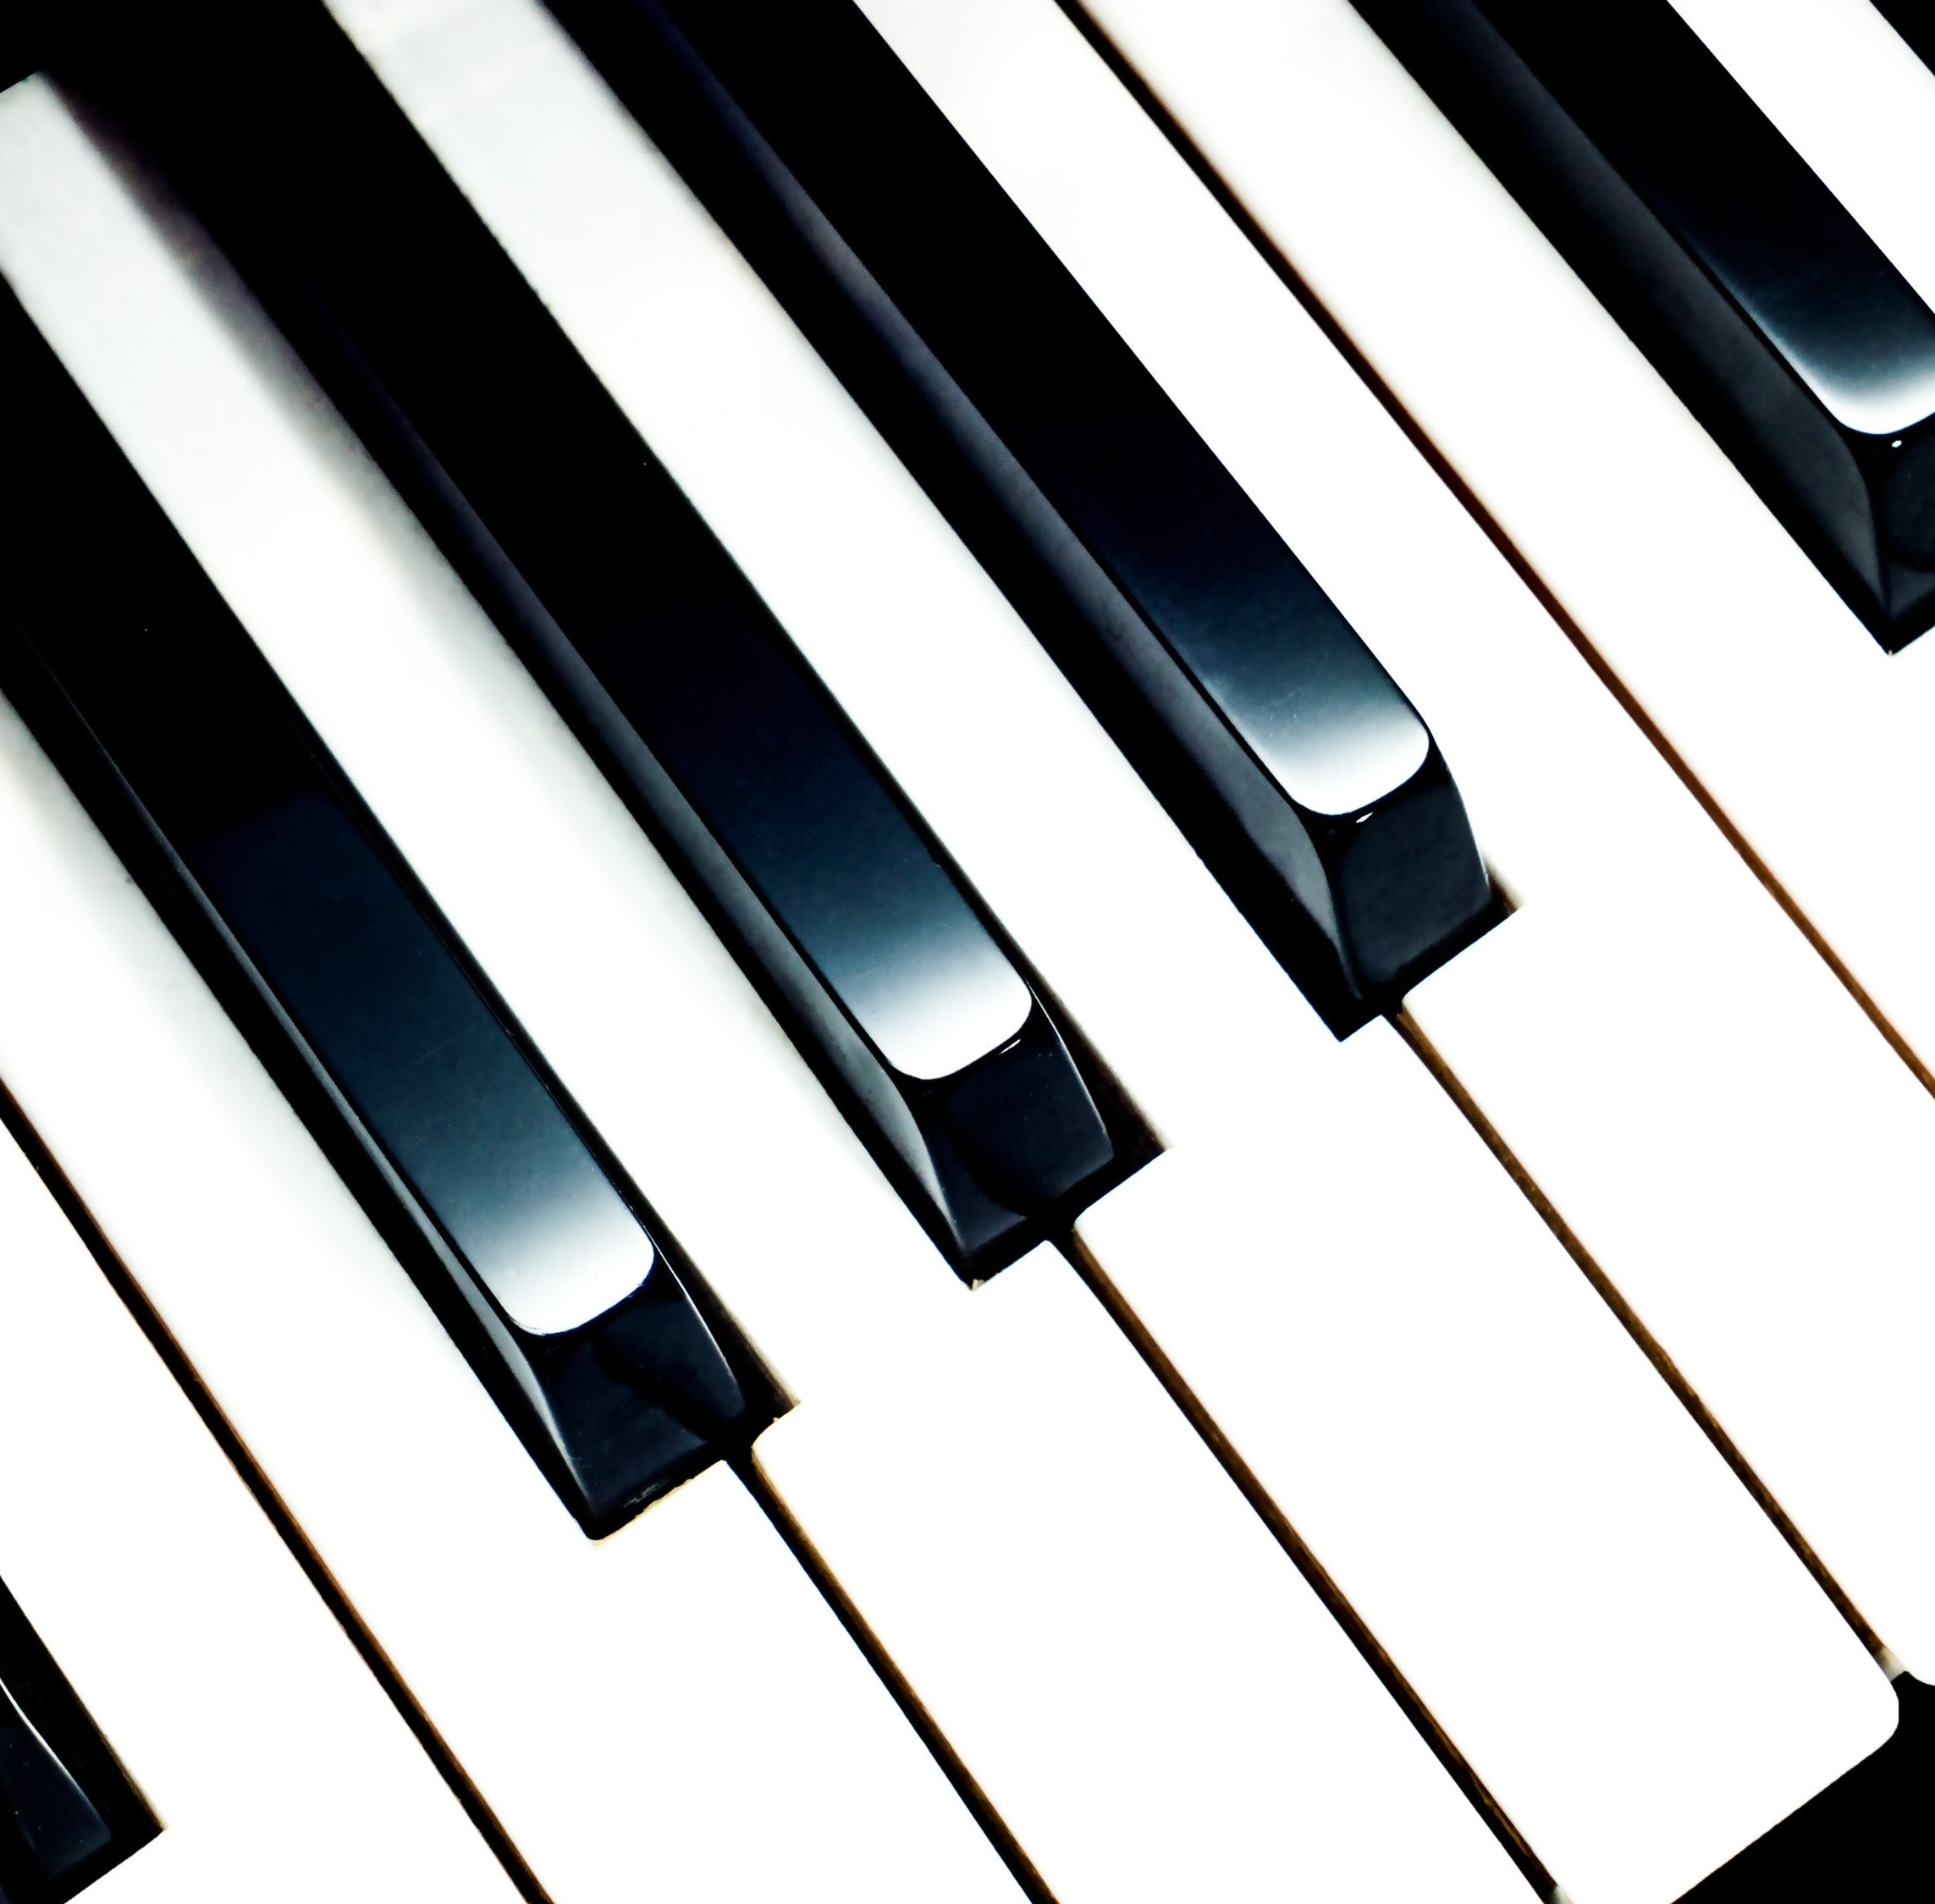
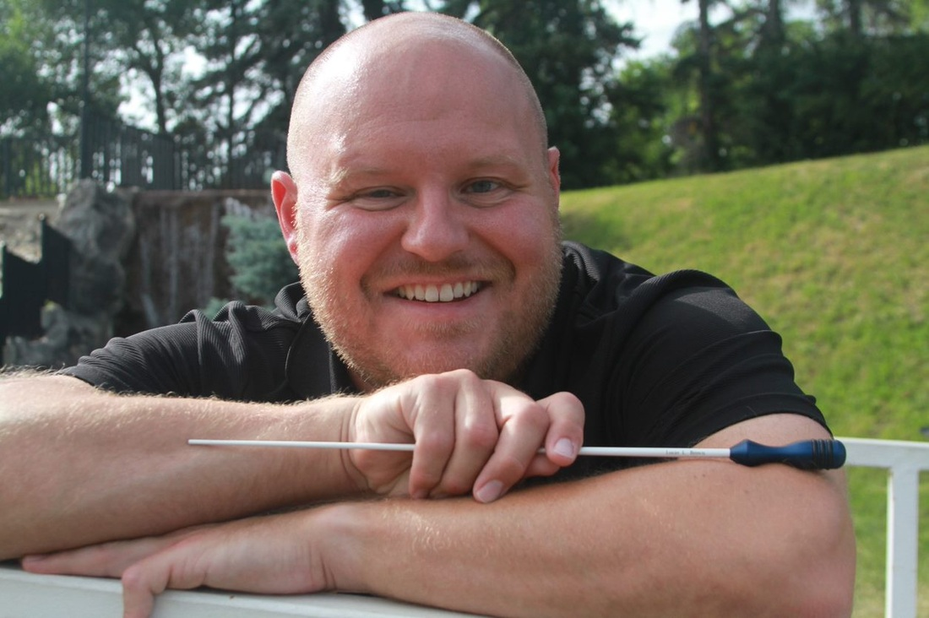
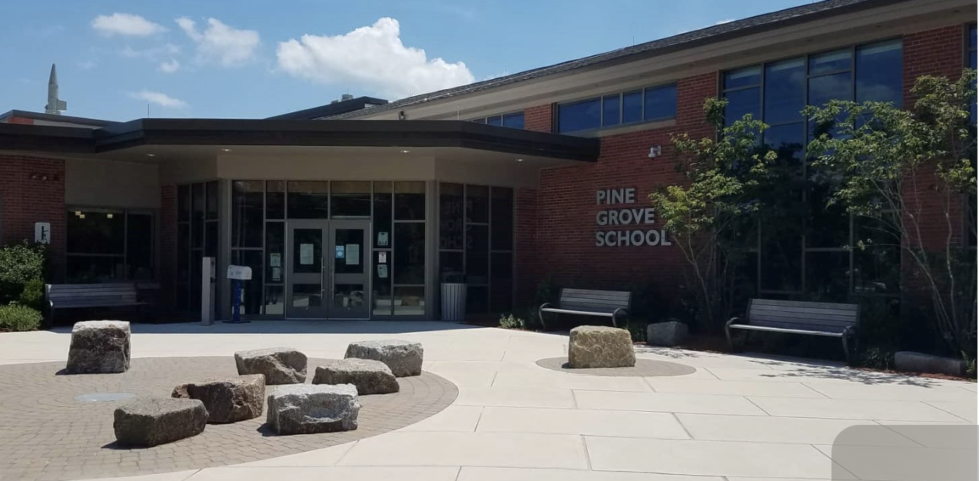
Lucas Brown
Native of Minot, ND
Taught in ND for 13 years
Currently live in Everett, MA
Teach in Rowley, MA
Will be starting my 15th year

Slide 3
My Role as an Educator
Teach Pre-K- 6th Grade Music, Elementary Choir 4-6 Grade, 4th Grade Beginning Band Lessons, Beginning Band, Advanced Band, Drum Circle, Elementary Musical Theater.

Slide 4
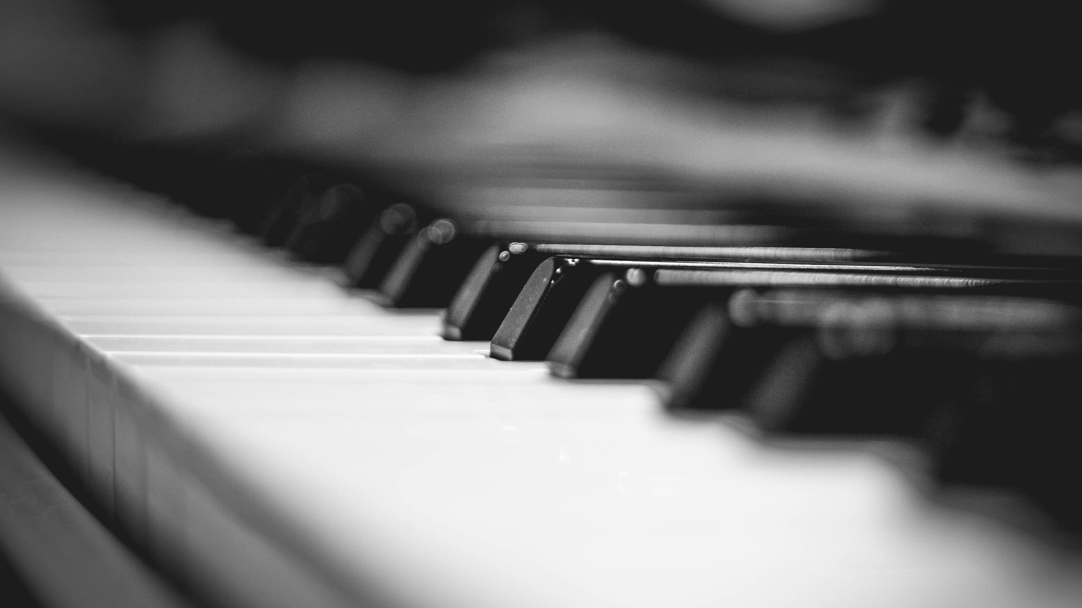
Why the Piano?
Provides a strong foundational start in many areas of music:
Rhythm
Sight Reading
Music Reading
Theory
Composition
Hand Independency
Music Fluency: transferrable to any instrument.
Fine Motor Skills
IT IS EXTREMELY VERSATILE!!!

Slide 5
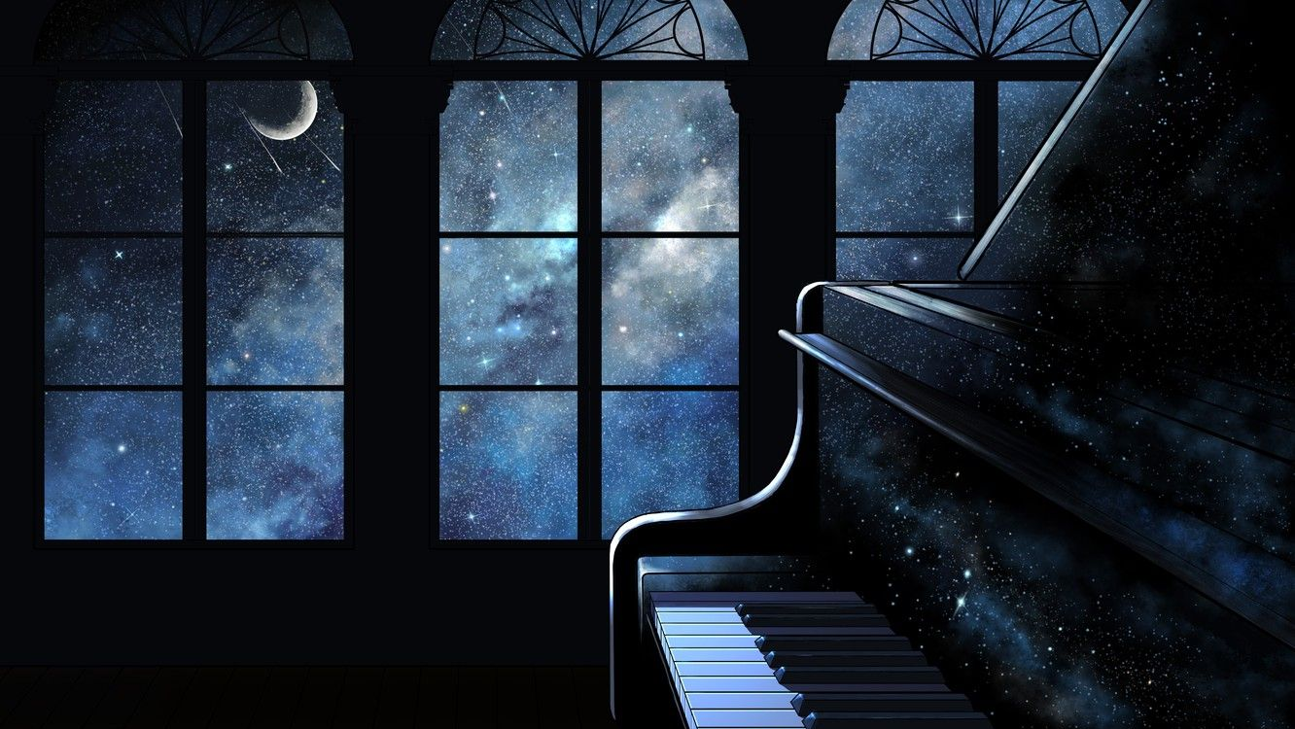
Literature for the Piano
There is vast selection of literature for the piano- nearly impossible to create a complete repertoire list.
- Method Books
Solo Literature
Piano Concertos
Ensemble Literature- just as vast as the solo literature
Piano duets-
4 hands, and 4 hands and 2 pianos
Piano Trios
Piano Quartets, etc.
Finite

Slide 6
How do I get started?.....
Basics, posture, hand position, and technique formation.
Try this……
Sit up tall, do not slouch, if you slouch you will slide off the piano bench,
Arrange yourself where your fingertips touch the finger board (the space behind the keys)
Knees are 90 degrees, and perpendicular to the floor.
Left foot should be slightly behind the right foot (right foot uses the damper pedal).
HAND POSITION

Slide 7
How do I get started?.....
Finger Independency
Wiggle Fingers individually on each hand, then together on both hands.
NOTE: STUDENTS MAY NOT BE ABLE TO WIGGLE FINGERS 4 AND 5 SEPARATELY AT THE START.
FINGER STRETCHING/FLEXIBILITY/DEXTERITY
It is important to stretch, because there is a possibility of ceasing up your hands, or they cramping.
BREATHING

Slide 8
Recommended Pianists for Listening
Peter Bence- https://www.youtube.com/watch?v=VxneFyWEVdQ
- Jarrod Radnich
- Yiruma
- Lionel Yu
- Jon Schmidt- Piano Guys
- Jacob Collier
- Brad Mehldau
- Martha Argerich
- Mitsuko Uchida
- Andras Schiff
- Lang Lang
- Helene Grimaud

Slide 9
Professional Organizations for Piano Teachers
- New England Piano Teachers Association-
https://nepta.com/to-join/?gclid=Cj0KCQjwntCVBhDdARIsAMEwACmJYusKUO53d2OB9anPABEsNnXLoc-Wq-Rcr3kWzH6Aw5f-V1FG95caAhBrEALw_wcB
- Music Teacher’s National Association-
https://www.mtna.org/
- Saint Paul Piano Teacher’s Association-
https://sppta.org/membership
- American College of Musicians (USA)-
https://pianoguild.com/
- National Federation of Music Clubs-
https://www.nfmc-music.org/

Slide 10
Section 1 References
References
Son, J. W. P. and. (n.d.). Jwpepper.com. J.W. Pepper Sheet Music. Retrieved June 8, 2022, from https://www.jwpepper.com/sheet-music/welcome.jsp
Alaska Piano Competition Repertoire List (Intermediate) i6. University of Alaska Anchorage. (n.d.). Retrieved June 8, 2022, from https://www.uaa.alaska.edu/academics/college-of-arts-and-sciences/
Suggested repertoire - piano festival - ihsma.org. (n.d.). Retrieved June 8, 2022, from https://ihsma.org/wp-content/uploads/2017/02/piano_sug_rep.pdf

Slide 11
Section 2 References
Finger numbers: Piano scales, piano, free piano lessons. Pinterest. (2012, February 2). Retrieved June 14, 2022, from https://www.pinterest.com/pin/finger-numbers--95983035778163243/
Do I really need to follow the fingerings in my piano music? Musicnotes Now. (2021, March 8). Retrieved June 14, 2022, from https://www.musicnotes.com/now/tips/do-i-really-need-to-follow-the-fingerings-in-my-piano-music/
Forty Bach Chorales - pjb.com.au. (n.d.). Retrieved June 14, 2022, from https://pjb.com.au/mus/free/satb_chorales.pdf

Slide 12
Section 3 References
Milstein, H., G, M., Kelly, T. J., Gelman, B. M., Es, Kernen, W., Seve, V., Any, & Shayeva, E. (2021, January 8). 16 of todays greatest living classcial pianists~ the sound advocate. The Sound Advocate. Retrieved June 23, 2022, from https://www.thesoundadvocate.com/2018/10/16-of-todays-greatest-living-classical-pianists/
Nugent, J. (2021, November 5). The 12 best modern pianists you should know. Higher Hz. Retrieved June 23, 2022, from https://higherhz.com/best-modern-pianists/
Recommended Websites (Reference Format APA 7)
Fun and affordable sheet music, worksheets, and Lessons Kids Love and teachers trust. MakingMusicFun.net - Sheet Music, Lesson Plans & Composer Resources. (n.d.). Retrieved June 23, 2022, from https://makingmusicfun.net/
Piano Teachers connect. Piano Teachers Connect. (n.d.). Retrieved June 23, 2022, from https://pianoteachersconnect.com/
Piano Teaching Resources, teaching kids & teenagers piano | teach piano ... (n.d.). Retrieved June 23, 2022, from https://www.teachpianotoday.com/
Website builder for music teachers with templates. Bandzoogle. (n.d.). Retrieved June 23, 2022, from https://bandzoogle.com/websites-for/music-teachers?utm_source=google&utm_medium=cpc&utm_campaign=Search_Customer_Types&utm_content=Music_Teachers&utm_term=piano+teacher+website&device=c&kw_matchtype=e&network=g&gclid=Cj0KCQjwntCVBhDdARIsAMEwACnExvXSz42F0d5mIBmh1418cS5Bz99M027YGz7OHEtdrYP1oTsKpP0aAoX6EALw_wcB

